Slide 1

Building an Accident Prediction Model Using Machine Learning Algorithms on Heterogeneous Sparse Data
EEE 511: Artificial Neural Computation
Team 6: Anirudh Srinivasan, Manohar Akula, Pranav Murali, Srikanth Sampath
Keywords: Neural Structured Learning, Hummingbird, Adversarial Regularization

Slide 2
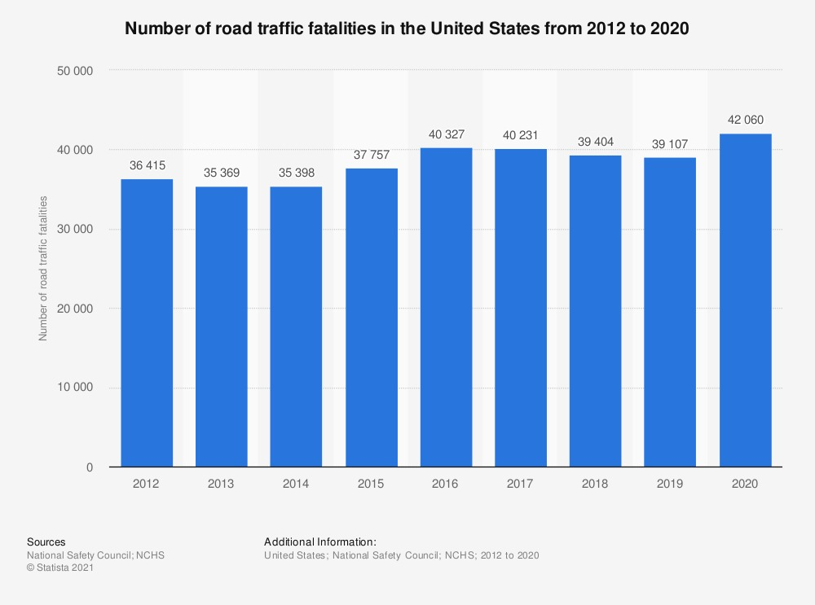

Problem Significance
Minimizing road accidents is one of the paramount challenges faced by the United States today
The country witnesses an alarming 100 deaths each day. CDC claims that road accidents is the leading cause of death in the country.
With more vehicles on road, the problem only looks to get severe as time passes if necessary appropriate action isn’t taken in time
Existing studies used small-scale datasets with limited coverage or large datasets which missed important contextual information
EEE 511: Team 6

Slide 3
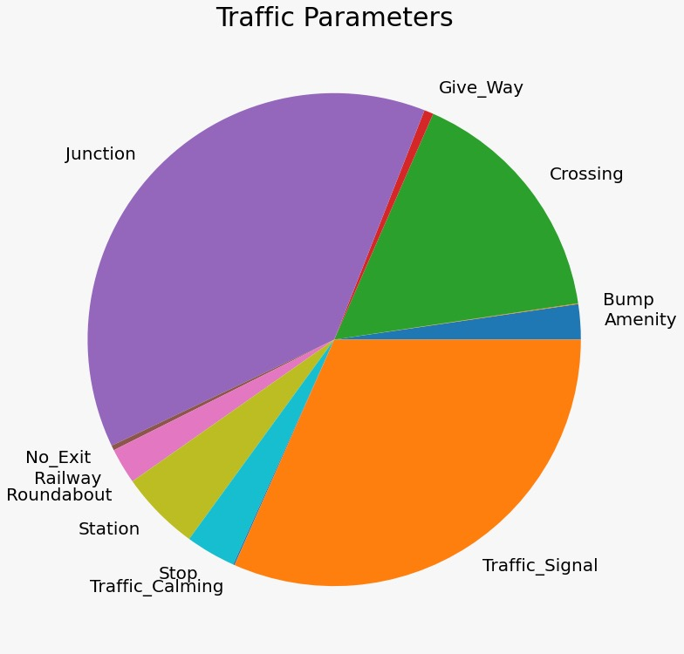
Problem Statement
Previous studies to predict accident along with severities were confined to specific regions or did not consider wide range of features
In this project, we propose to build a robust machine learning model that utilizes data covering the entire country along with various features
We make use of wide range of data events like traffic congestion, hazards, temperature, wind speeds, traffic signals, junction, week, hour and period of the day
EEE 511: Team 6

Slide 4
Dataset Description
The dataset used contains information about traffic accidents across 49 states of the United States
The data has been compiled from February 2016 to December 2020
It currently has around 3 million records as of today
Data has been captured and compiled into a single dataset from multiple entities such as US State Department of Transportation, Law Enforcement Agencies and Traffic Cameras and Sensors
This dataset contain 47 columns and the data is broadly classified into four different categories: Traffic Events, Weather Events, Address Events and Points-of-Interest Events
EEE 511: Team 6

Slide 5
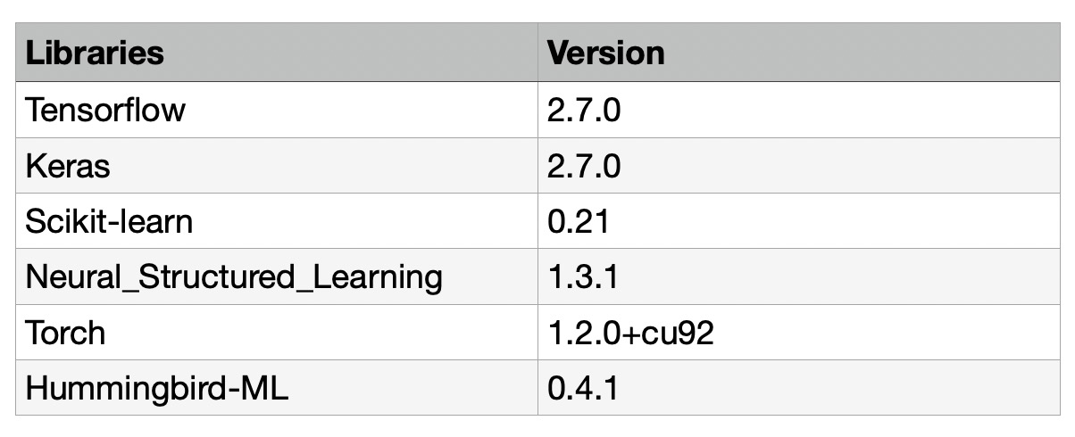

Computing Requirements
Local System Requirements:
12GB RAM
Windows/Mac OS
6 GB Graphic Card
We recommend using python 3.x and install the following libraries:
Tensorflow
Keras
Scikit-learn
Neural Structured Learning
Torch
Hummingbird-ml
EEE 511: Team 6

Slide 6
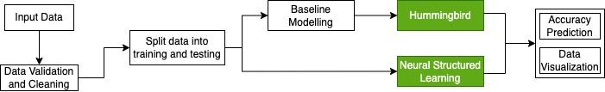
Project Workflow and Baseline Modelling
Initially, we implement different baseline models for model building and these include Logistic Regression, K-Nearest Neighbor, Decision Tree, Random Forest and MLP Classifier
We transform the cleaned dataset into train and test in the ratio 80:20 and then we train the baseline models and measure accuracies
EEE 511: Team 6

Slide 7
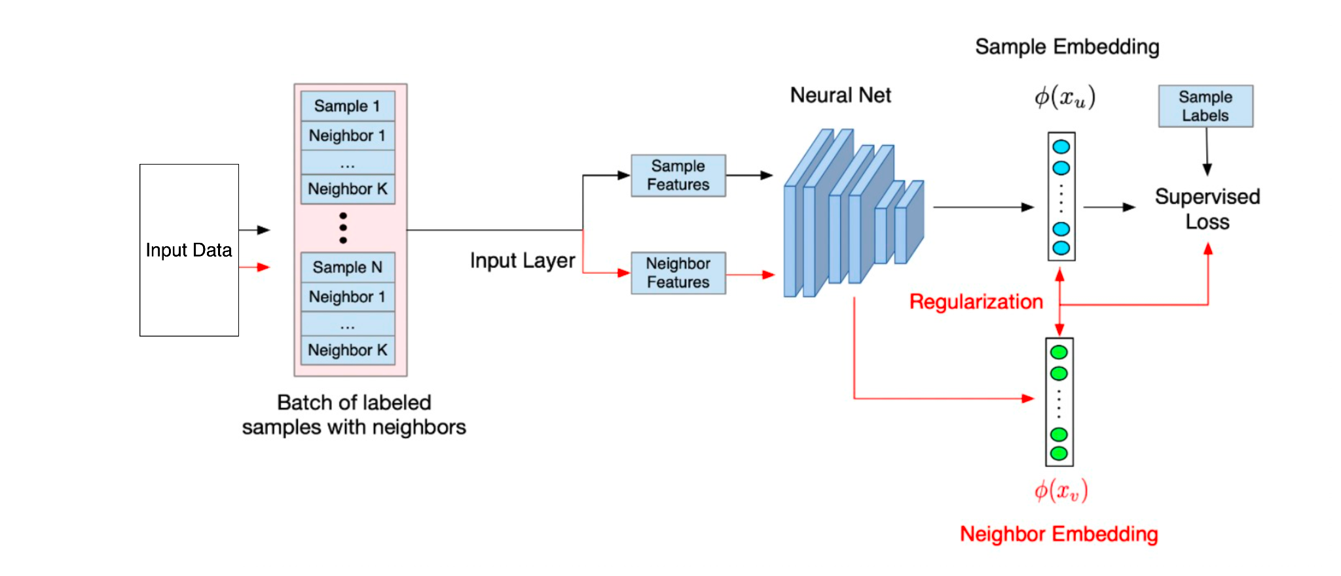
Neural Structured Learning
Introduced by Google in 2019, Neural Structured Learning (NSL) is a novel state-of-the-art machine learning Neural Network Model
NSL is unique as it identifies input perturbations that might mislead the model to give erroneous predictions
Structured signals are used to regularize training of neural network forcing the model to make accurate predictions by minimizing supervised loss while at the same time minimizing neighbor loss and maintaining input similarity
EEE 511: Team 6

Slide 8
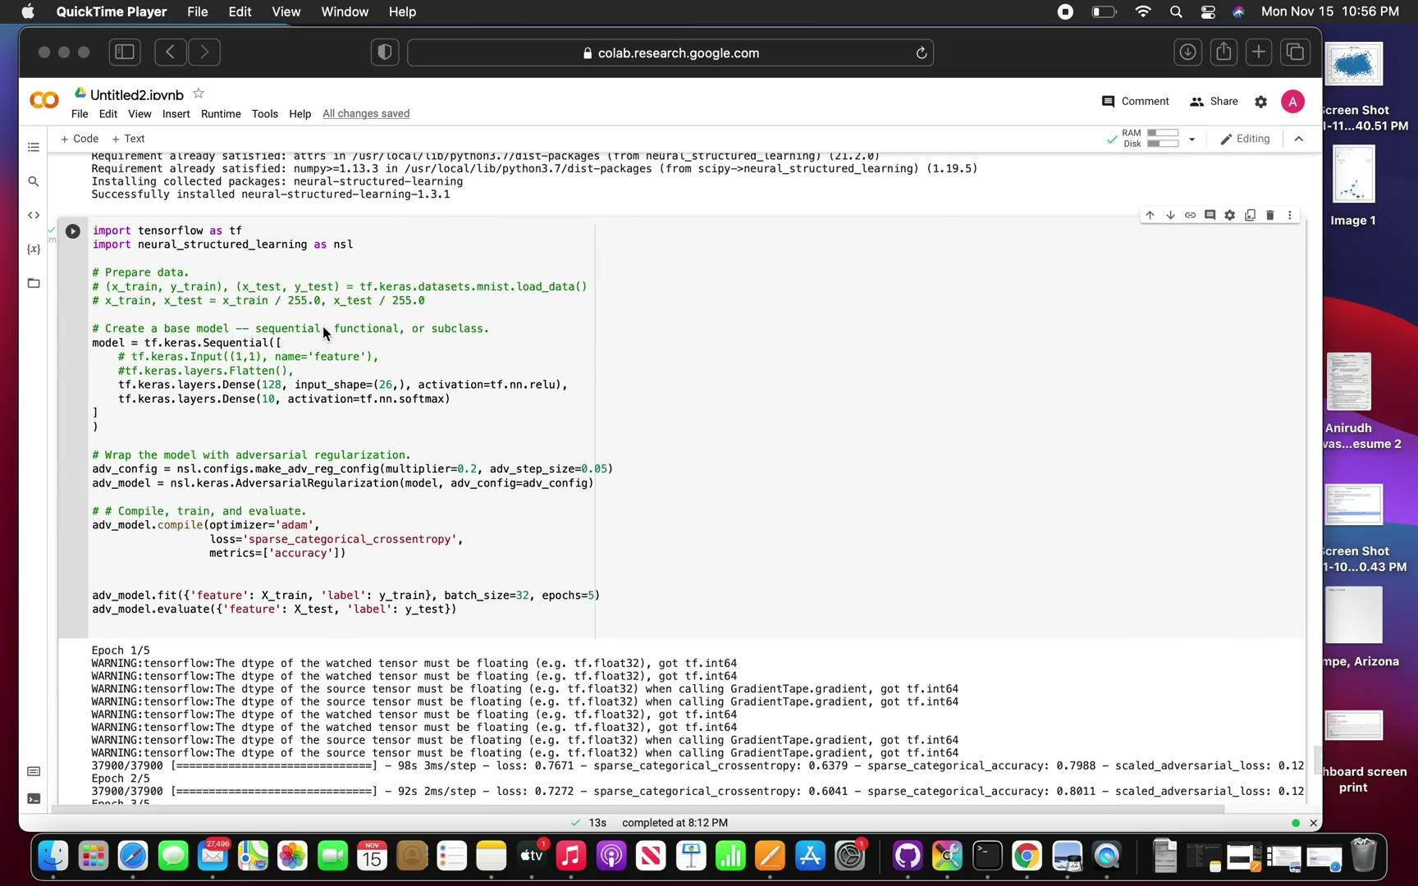
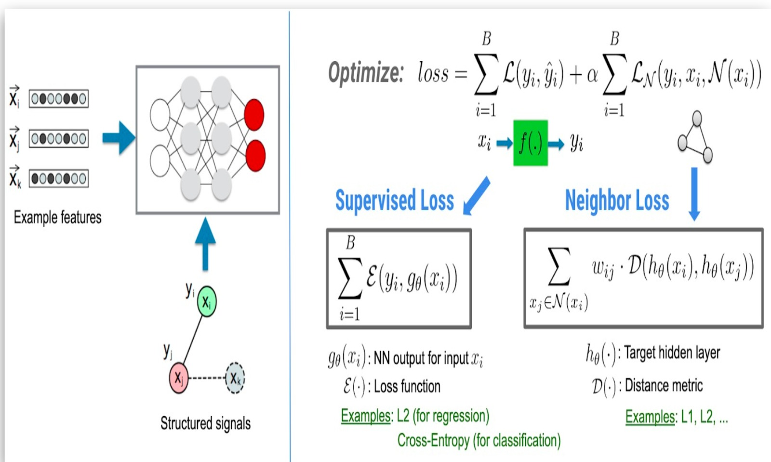
Neural Structured Learning(contd)
The loss optimized for NSL is a combined sum of the supervised and neighbor losses
EEE 511: Team 6

Slide 9
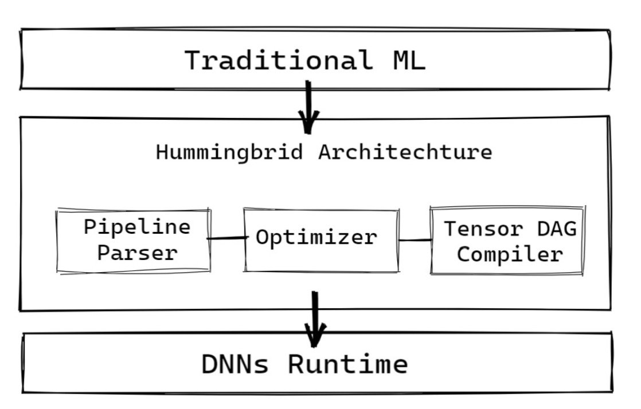
Hummingbird
Introduced by Microsoft in 2020, it is a novel machine learning tool that would help in dealing with bottlenecks that arise due to computational capabilities of machine learning models
It helps in the integrations of models to the PyTorch framework that helps in optimal utilization of GPUs and obtain better performances
Hummingbird helps in compiling machine learning pipelines in the form of tensor pipelines that help deal with neural networks
EEE 511: Team 6

Slide 10
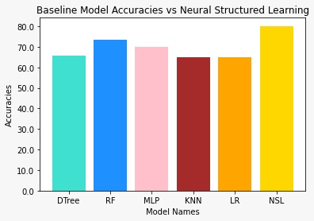
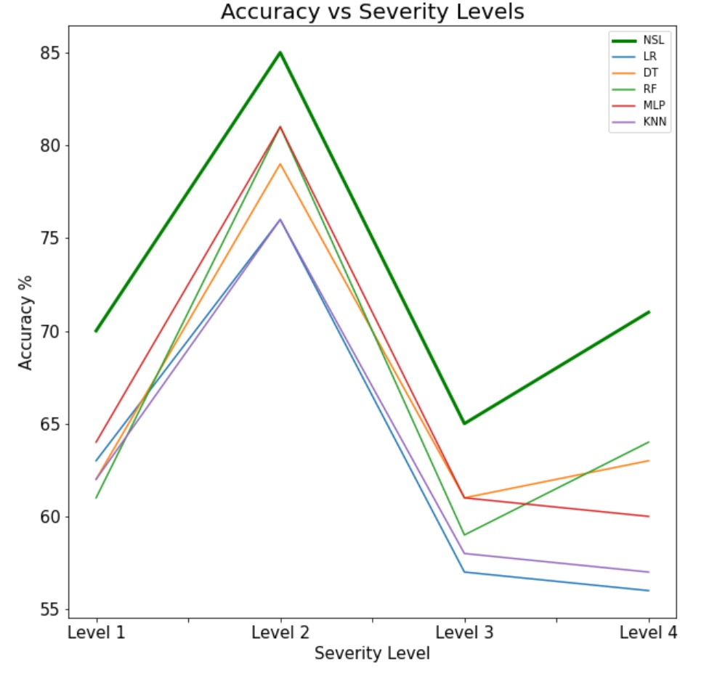
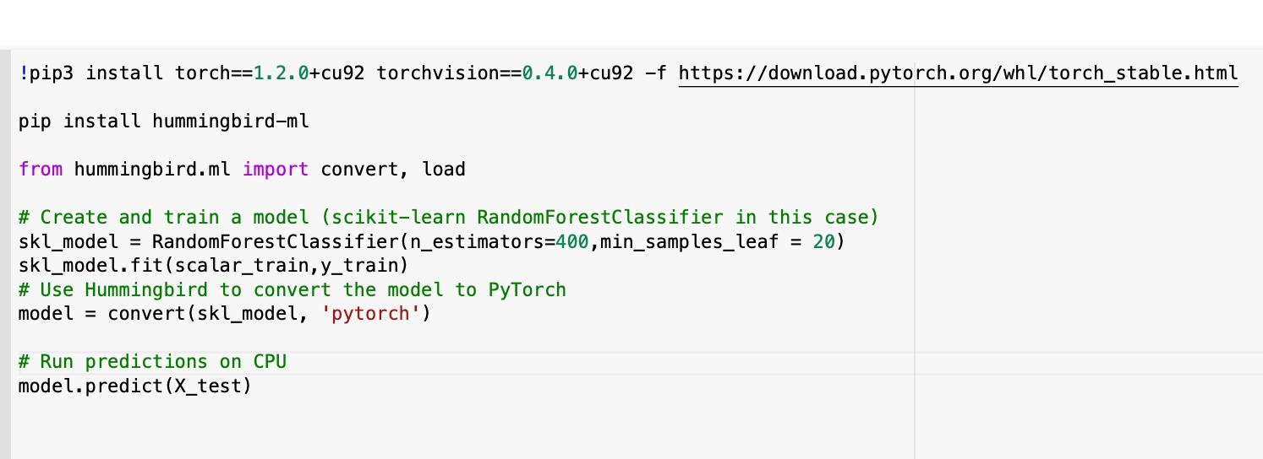
Observations
First graph shows NSL with the highest accuracy of 81% against the baseline models
The second graph displays the case where NSL is able to predict better for Severity level 3 and 4 (fewer records of data points)
Code snippet of the hummingbird integration for one of the baseline models
EEE 511: Team 6

Slide 11
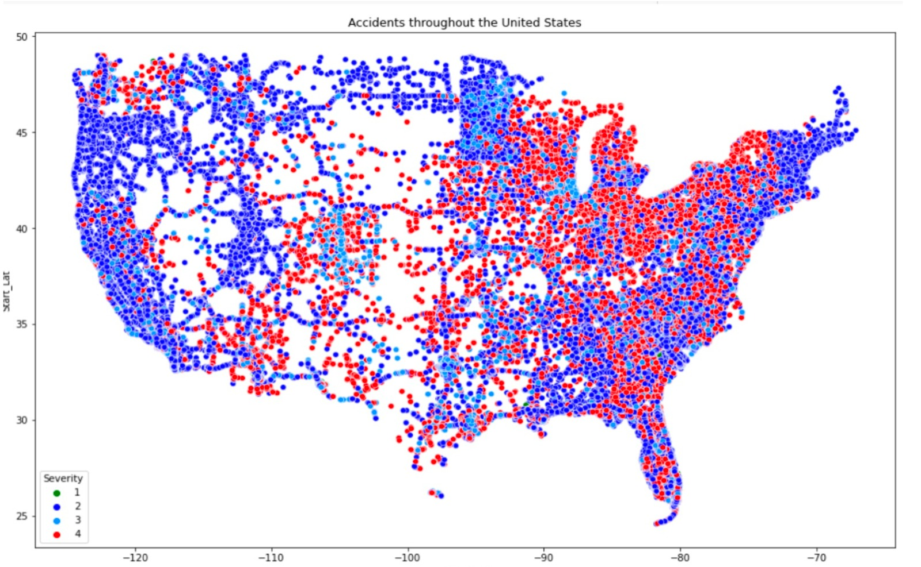
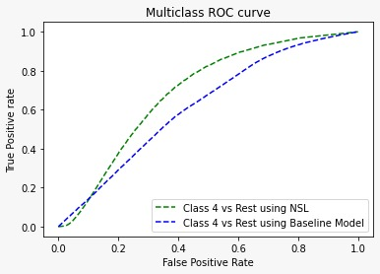
Results
After implementing the proposed ML models, NSL model achieved an accuracy of 81% and performed better compared to the baseline models
Interestingly, a few interstates contributed majorly to severity level 4 accidents
Integration of Hummingbird for supervised ML models significantly reduced the runtime
NSL achieved significantly higher true positivity rate especially for the severity level 4 as seen in the figure
EEE 511: Team 6

Slide 12
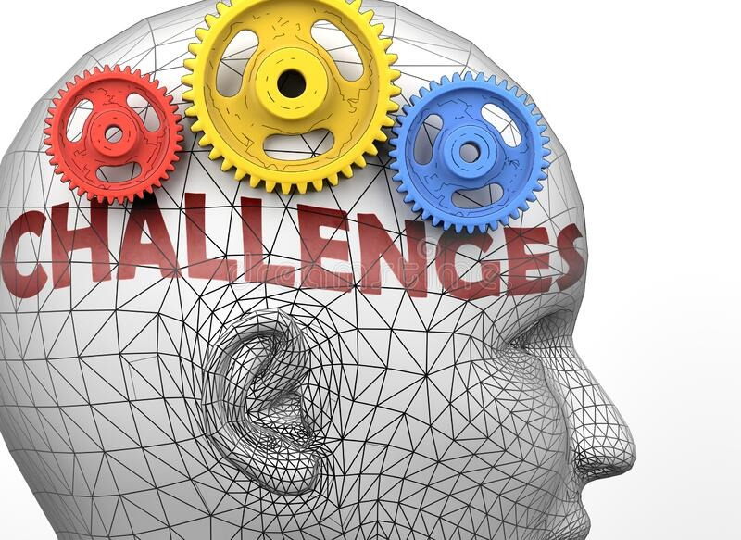
Challenges Faced
Integrating dynamic datasets with newer records and attributes
Building robust model making accurate predictions with less labelled data
Hyper parameter tuning to obtain optimal model results

Slide 13

Conclusion and Future Scope
Conclusion
Using countrywide accident dataset, state-of-the-art model built to predict accident severity
Coordinate with ground response teams for timely intervention
Urban planners can leverage findings to identify potential points of interest
Future Scope
Integrating Microsoft’s Hummingbird with all the ML models
As the model keeps learning, the accuracy can be further increased using dynamic dataset
Creating positive impact with comprehensive usage of NSL and Hummingbird
EEE 511: Team 6

Slide 14
References
Research Papers
S. Moosavi et al. 2019’Accident Risk Prediction based on Heterogeneous Sparse Data: New Dataset and Insights’. SIGSPATIAL ’19, November 5–8, 2019, Chicago, IL, USA
US-Accidents: A Countrywide Traffic Accident Dataset, 2021. [Online]. Available: https://smoosavi.org/datasets/ us_accidents
CDC, 'Road Traffic Injuries and Deaths—A Global Problem’, 2020. [Online]. Available: https://www.cdc.gov/ injury/features/global-road-safety/index.html
CDC, ‘Cost Data and Prevention Policies’,2020. [Online]. Available: https://www.cdc.gov/ transportationsafety/costs/index.html
Datasets Source
https://www.kaggle.com/sobhanmoosavi/us-accidents
Code Repository
https://github.com/1997anirudh/ANC-Project-
EEE 511: Team 6

Slide 15

Have any questions??
Team 6: Anirudh Srinivasan, Manohar Akula, Pranav Murali, Srikanth Sampath
EEE 511: Team 6

Slide 16
Contributions
Team Member | Work Contributed
Anirudh Srinivasan | Video compilation and theory
Manohar Akula | Screenshots and references
Pranav Murali | Theory and problem statement formulation
Srikanth Sampath | Key concepts and theory formulation
EEE 511: Team 6

